Slide 1
I/3. Data Analysis, Data Transformation AND Data Cleaning with Pandas I.
Data Analyst Intermediate – PYTHON-based Data Analysis, Data Cleaning, Data Visualization & Predictions
Data Analyst Intermediate
Trainer: Szabolcs Jobbagy

Slide 2

The Pandas library
Start a new notebook
"PANDAS" is a library for Python for analyzing, transforming, filtering, cleaning data tables: https://pandas.pydata.org/docs/reference/index.html
Libraries can be "called" into the code like this: import ……
as …… -> we can give it an abbreviated name (alias), which can be easier to type later in the code
# import the pandas data analysis library import pandas as pd

Slide 3
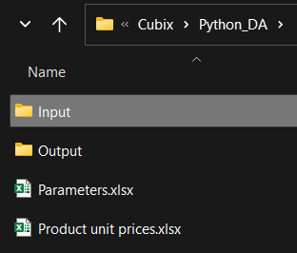
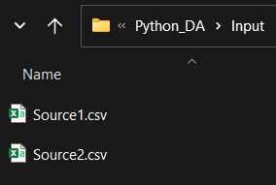
Base data of folders and files
It's recommended to put the base data (data of input and output folders, and files etc.) to the top of the program
It's easy to find them and it's also easy to change them later (we don't need to scroll down and look for them inside the code)
# base data basepath = r'…' inputfolder = 'Input' inputfile = 'Source1.csv' outputfolder = 'Output' outputfile = 'Revenues.csv'

Slide 4
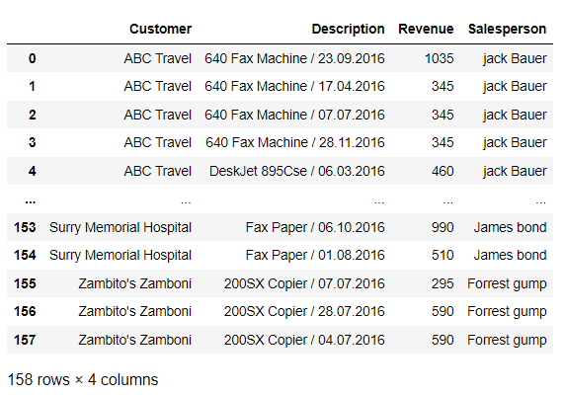
Reading CSV files into Dataframes
pd.read_csv: Read a CSV file into a Pandas Dataframe (it's a 2-dimensional data structure with rows and columns, a "table")
df: standard variable name for the dataframe
sep: separator character in CSV (semicolon, comma etc.)
encoding: encoding type of file (UTF-8, UTF-16 etc.)
# read data from csv file into a dataframe df = pd.read_csv(basepath + '\\' + inputfolder + '\\' + inputfile, sep = ';', encoding = 'utf-8') df
row index
column names / headers
row 0
row 1
row 2
row 3
row 4
…

Slide 5

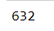

Data about the Dataframe
df.shape: the number of rows and columns of the dataframe
df.size: the size of the dataframe, i.e. the number of its elements
df.columns: column names / headers of the dataframe
# number of rows and columns df.shape
# number of elements df.size
# column names df.columns

Slide 6
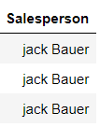
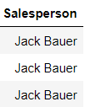
Capitalize each word in Dataframe column
column.str.title(): capitalize each word in the column's values
# capitalize each word in column df['Salesperson'] = df['Salesperson'].str.title() df

Slide 7


Trim leading and trailing spaces in column
column.str.strip(): removes spaces in the beginning or end of text in the column (does NOT remove unnecessary extra spaces between words)
# the value in the 1st row of column df['Customer'][0]
# removes spaces before and after the text df['Customer'] = df['Customer'].str.strip() df['Customer'][0]
# show the column's values df['Customer']

Slide 8
Replace texts in column
column.str.replace: replace texts in the column
\s+: one or more repeating spaces (this is a "regex" code, which are easy abbreviated codes for text filtering)
In earlier Pandas versions regex usage was set to True by default, but in newer versions we have to set it to True manually (regex = True)
Note that replacing repeating spaces to 1 space does NOT remove the 1 space in the beginning or end of text -> for that we need the strip()
# replace double space to single df['Customer'] = df['Customer'].str.replace(' ', ' ') df['Customer'][0]
# replace 2, 3, 4 etc. spaces to 1 df['Customer'] = df['Customer'].str.replace('\s+', ' ', regex = True) df['Customer'][0]

Slide 9
Splitting texts to columns
column.str.split: Split text along a given (even multi-character) separator in a column, e.g. ' / ' (space, comma, space)
If no separator is given, it will be SPACE
expand = True: puts elements in separate columns
# split text to columns df[ ['Product', 'Date'] ] = df['Description'].str.split(' / ', expand = True) df
# split text to columns df[ ['Day', 'Month', 'Year'] ] = df['Date'].str.split('.', expand = True)

Slide 10
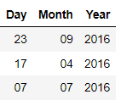

Merging columns
df.agg: aggregation with a function
separator.join: concatenating with the separator
axis: the axis of dataframe (0: row axis, 1: column axis)
# merge columns by separator df['Date'] = df[ ['Year', 'Month', 'Day'] ].agg('.'.join, axis = 1)

Slide 11




Changing column data types
column.dtype: data type of column (df.dtypes: all columns)
column.astype: change column data type
str / object: text (string)
int32, int64: integer (max. 32- or 64-bit)
float32, float64: floating-point number (integer / fraction) – can be converted to numeric before to avoid errors
datetime64[ns]: datetime (in nanosecond precision)
pd.to_numeric(column, errors = 'coerce'): convert column to numeric
errors = 'coerce': in case of error, it will be NaN (missing)
# show data type of column print(df['Date'].dtype)
# show data types of all columns print(df.dtypes)
# convert column's data type to datetime df['Date'] = df['Date'].astype('datetime64[ns]')
# convert column to numeric df['…'] = pd.to_numeric(df['…'], errors = 'coerce') # convert column's data type to float df['…'] = df['…'].astype(dtype = 'float64', errors = 'ignore')

Slide 12
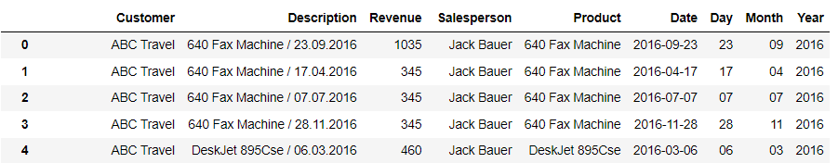
Deleting columns and rows
df.drop: delete, remove rows or columns
axis: the axis of the dataframe (0: row, 1: column)
# delete column df = df.drop(['Description'], axis = 1)
# delete multiple columns df = df.drop(['Day', 'Month', 'Year'], axis = 1)
# delete row -> to new dataframe df2 = df.drop([1], axis = 0)
# delete first 3 rows -> to new dataframe df2 = df.drop([0, 1, 2], axis = 0)
# delete filtered rows -> to new dataframe df3 = df.drop(df.index[ df['Product'] == '640 Fax Machine' ])

Slide 13
Renaming columns
df.rename: rename columns
# rename column df2.rename(columns = {'Customer': 'Client'}, inplace = True)
# rename multiple columns df2.rename(columns = {'Revenue': 'Sales', 'Salesperson': 'Salesclerk'}, inplace = True)

Slide 14
Reordering column sequence
The new order of the columns can be specified simply by listing the column headers
df.pop(columnname): "cuts" the column's values and then they can be inserted elsewhere
df.insert: Insert a new column
we enter its position (0),
its name ('Product'),
and its values (this can be empty or can be calculated from other columns with a formula)
# change order of columns df = df[ ['Customer', 'Product', 'Date', 'Revenue', 'Salesperson'] ]
column_values = df.pop('Product') # moving column to another position df.insert(0, 'Product', column_values)

Slide 15
Adding new columns
df.insert: Insert a new column
we enter its position (0),
its name ('Product2'),
and its values (this can be empty or can be calculated from other columns with a formula)
If we simply define a new column name (df['Year']), it will be moved to the right edge of the table
column.dt.year: YEAR of the date in column
column.dt.month: MONTH of the date in column
If we get a warning for "chained assignment", disable it in advance
# insert new column with empty values df.insert(0, 'Product2', '')
# insert new column to the right edge of table df['Year'] = df['Date'].dt.year df['Month'] = df['Date'].dt.month
# do not warn for chained assignment pd.options.mode.chained_assignment = None

Slide 16
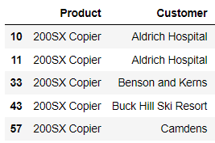
Sorting rows
sort_values: Sort the dataframe's rows
If there are both numbers and texts in a column, convert it to string, otherwise sorting will fail: column.astype(str)
Sort the data by "Date" column in ascending order
# sort dataframe rows by column df = df.sort_values(by = ['Product'])
# sort dataframe rows by column, descending order df = df.sort_values(by = ['Product'], ascending = False)
# sort dataframe rows by multiple columns df = df.sort_values(by = ['Product', 'Customer'])
# convert column's data type to string df['Productid'] = df['Productid'].astype(str)
# sort dataframe rows by column df = df.sort_values(by = ['Date'])

Slide 17
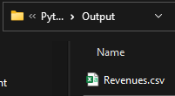
Exporting data to CSV files
df.to_csv: Export dataframe to CSV file
index = False: the index should not be included in a separate column
sep: separator character
encoding: encoding type (if you have accented letters, you should choose UTF-8)
# export dataframe to csv file df.to_csv(basepath + '\\' + outputfolder + '\\' + outputfile, index = False, sep = ';', encoding = 'utf-8')
print('Data cleaning done!')

Slide 18

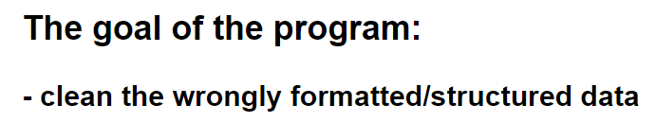
Creating a Markdown
At the top of our code insert a cell above the first program cell (shortcut key: A)
Type the goal of the program as comment
Then in Command mode turn this cell to "Markdown" (shortcut key: M), which is an easily formatted text where we can use headings
#: Heading1
##: Heading2 etc.
After you run the cell, it will look like normal text
To convert cell back to code, in Command mode press: Y
# The goal of the program: ## - clean the wrongly formatted/structured data

Slide 19


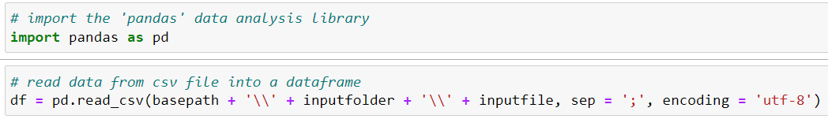
Tasks can be organized to separate programs
Start a new notebook, and from the "Clean_data" program move the exporting part to it, organizing this separate task into a separate program (we will change "df" to "df_export" which is more specific)
Now we have a separate program to do this task with our customized parameters
It's a general principle that if we use a task many times repeatedly, in different programs, it is worth organizing it into a separate program, so we can reuse it anytime, anywhere
Organize also the data reading part into a new "Read_csv" program
# export dataframe to csv file df_export.to_csv(basepath + '\\' + outputfolder + '\\' + outputfile, index = False, sep = ';', encoding = 'utf-8')
print("Exported to CSV!")

Slide 20
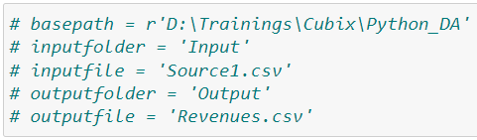

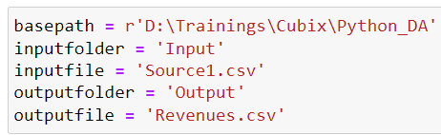
Running other Python programs 1.
In "Clean_data.ipynb" let's convert these lines to comments (CTRL + /), then save the notebook
Start a new notebook, and copy-paste basepath, input/output folder & file data, so that it will be easy to change them later
%run programname.ipynb: Run another Jupyter Notebook program
# Run another program in the same folder %run Read_csv.ipynb %run Clean_data.ipynb
# Run another program one folder level down %run \Subfoldername\Programname.ipynb
# Run another program one folder level up %run ..\Programname.ipynb

Slide 21
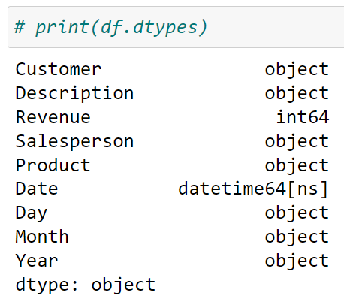
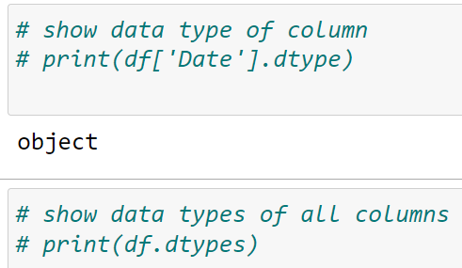
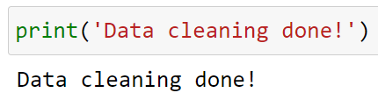
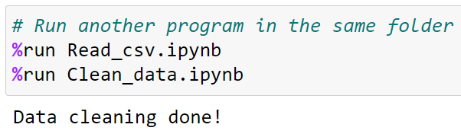
Running other Python programs 2.
When we run all "Slicing" program, we will see all the outputs from the "Clean_data.ipynb" where we used print()
Go back to "Clean_data.ipynb" and let's convert these lines to comments (CTRL + /), then save the notebook
Only the last user notification should remain
Now if we run all "Slicing" program, we can see only the last message

Slide 22
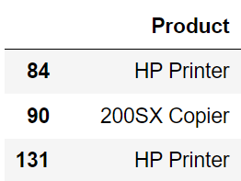
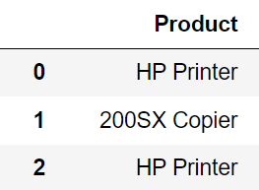
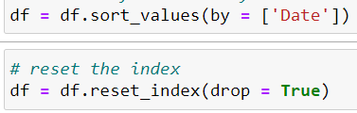
Resetting the index
After sorting a dataframe, the index numbers will be mixed
reset_index: Reset the index
drop = True: Drops the old index (If not used, the old index will be inserted into a new, separate column)
Open "Clean_data" program and reset index after sorting rows
# reset the index df = df.reset_index(drop = True)

Slide 23
Slicing, filtering the Dataframe 1.
Using LOC: using labels of rows/columns
# rows and columns by labels (from … to) df.loc[3:6, 'Customer':'Revenue']
# columns by labels (from … to) df.loc[:, 'Customer':'Revenue']
# rows by labels (from … to) df.loc[3:6, :]
# value in cross section of row and column df.loc[4, 'Revenue']
# filter on value (greater/less than) df.loc[ df['Revenue'] > 1700, ['Product', 'Customer', 'Revenue'] ]
# filter on value (equal to) df.loc[ df['Product'] == 'HP Printer', ['Customer', 'Revenue', 'Product'] ]
# filter on value in multiple columns df.loc[ (df['Product'] == 'HP Printer') & (df['Revenue'] > 1000) ]
# first 5 rows df.head() | # last 5 rows df.tail()
# first x rows df.head(10) | # last x rows df.tail(10)

Slide 24
Slicing, filtering the Dataframe 2.
Using ILOC: using index of rows/columns (starts with 0)
the endpoint index is NOT included
# rows and columns by index (from … to) df.iloc[3:6, 0:3]
# last x rows in column (by column index) df.iloc[-3:, 1]
# last x rows in column (by column label) df.iloc[-3:, df.columns.get_loc('Customer')]
# last x columns in row (by column index) df.iloc[2, -3:]
# value in cross section of row and column (by index) df.iloc[4, 3]
# filter on value (greater/less than) df.iloc[ (df['Revenue'] > 1700).values, [0, 1, 3] ]
# number of rows rowcount = df.shape[0] | # number of columns columncount = df.shape[1]
# last row's index lastrow = df.shape[0] - 1 | # last column's index lastcolumn = df.shape[1] - 1

Slide 25


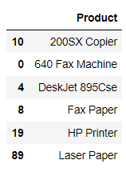
Removing duplicates
Start a new notebook and paste base path, folder and file data
Run "Read_csv" and "Clean_data" program
df.drop_duplicates: Remove duplicates
Create the Products dimension table in a new dataframe (in which there is no repetition): df_products
# decrease dataframe to only specific columns -> to new dataframe df_products = df[ ['Product'] ] # remove duplicates df_products = df_products.drop_duplicates()
# remove duplicates by columns -> to new dataframe df_products = df.drop_duplicates(subset = ['Product']) # decrease dataframe to only specific columns df_products = df_products [ ['Product'] ]
Both solutions do the task

Slide 26
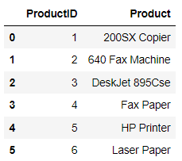
Inserting a new ID index column
As the index values are "spoiled", reset the index
If we want to insert a new "ID" column (1-2-3-4 etc. values), we can use insert:
we enter its position (0),
its name ('ProductID'),
and its values will always be 1 greater than the index of the dataframe row (df_term.index + 1)
# reset the index df_products = df_products.reset_index(drop = True)
# insert an ID column df_products.insert(0, 'ProductID', df_products.index + 1)

Slide 27
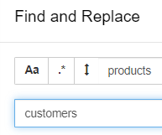

Quickly replacing texts in Python code
To see the products in alphabetical order, sort "df" by Product before removing duplicates
Select the cells of creating the Products dimension table, and merge them with SHIFT + M
Copy the cell (shortcut: C), then paste it twice (shortcut: V)
In Command mode, stand on any cell of the Python code, and press the letter F (Find and Replace)
Here we can specify what to replace, and with what text, then "Replace All" (replaces everything in the given cell)
Create also the Customers and Salespersons dimension tables
# sort dataframe rows df = df.sort_values(by = ['Product'])
in ALL cells

Slide 28
Exporting data to new Excel file
Export all 3 tables to CSV with the "Export_to_csv" program
df.to_excel: Export dataframe to a new Excel file
index = False: the index should not be included in a separate column
sheet_name: what should be the name of the worksheet
pd.ExcelWriter: Pandas "class" used to write dataframes into Excel sheets
# Export to csv outputfile = 'Products.csv' df_export = df_products %run Export_to_csv.ipynb
outputfile = 'Products.xlsx' # export to new Excel file df_products.to_excel(basepath + '\\' + outputfolder + '\\' + outputfile, index = False, sheet_name = 'Products')
outputfile = 'Dimension_tables.xlsx' # export to new Excel file, on multiple worksheets with pd.ExcelWriter(basepath + '\\' + outputfolder + '\\' + outputfile) as writer: df_products.to_excel(writer, sheet_name = 'Products', index = False) df_customers.to_excel(writer, sheet_name = 'Customers', index = False) df_salespersons.to_excel(writer, sheet_name = 'Salespersons', index = False)

Slide 29
Exporting data to existing Excel file
„OPENPYXL”: library for writing XLSX, XLSM files
pd.ExcelWriter
mode: 'a' = append (append as new worksheet), 'w' = write (overwrite file, other worksheets are deleted)
engine: which engine to write with – we can write to .XLSX files with the „OPENPYXL” library
# sort dataframe rows df = df.sort_values(by = ['Date']) outputfile = 'All_tables.xlsx' # export to new Excel file df.to_excel(basepath + '\\' + outputfolder + '\\' + outputfile, index = False, sheet_name = 'Revenues')
# import library for writing XLSX, XLSM files import openpyxl outputfile = 'All_tables.xlsx' # export to existing Excel file, append as new worksheet with pd.ExcelWriter(basepath + '\\' + outputfolder + '\\' + outputfile, engine = 'openpyxl', mode = 'a') as writer: df_products.to_excel(writer, sheet_name = 'Products', index = False) df_customers.to_excel(writer, sheet_name = 'Customers', index = False) df_salespersons.to_excel(writer, sheet_name = 'Salespersons', index = False)

Slide 30

Reading data from SQL database
Start a new notebook
"PYODBC": a module for accessing databases via ODBC connection
import pyodbc # module for accessing databases via ODBC connection import pandas as pd # connection data of SQL server and database driver = 'DRIVER={SQL Server}' # for MS SQL (driver is different for MySQL etc.) server = 'serverhostname' database = 'databasename' username = 'username' password = 'password' # connect cnxn = pyodbc.connect(driver + ';SERVER=' + server + ';DATABASE=' + database + ';UID=' + username + ';PWD=' + password)
# SQL query to pre-filter data query = 'SELECT o.OrderDate, c.Country, od.LineTotal, p.ProductSubcategoryID \ FROM Customer c \ JOIN Orders o on c.CustomerID = o.CustomerID \ JOIN OrderDetail od on od.OrderID = o.OrderID \ JOIN Product p on p.ProductID = od.ProductID;'
# read the data from the SQL database based on the query df = pd.read_sql(query, cnxn)

